Slide 1
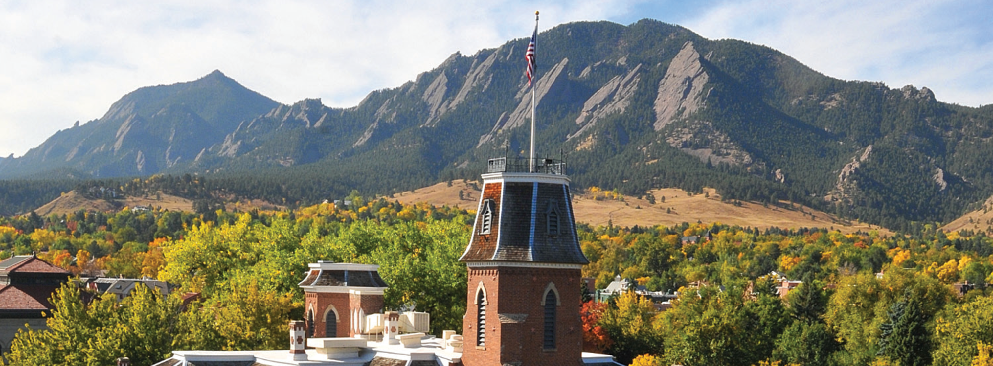
Cloud 101: Introduction to Commercial Cloud Computing

Slide 2
Working with Cloud
Mohal Khandelwal
Research Computing
Website: www.rc.colorado.edu
Helpdesk: rc-help@colorado.edu
Dylan Gottlieb
Research Computing
Website: www.rc.colorado.edu
Helpdesk: rc-help@colorado.edu
Slides: https://github.com/ResearchComputing/cloud101_primer
Survey: http://tinyurl.com/curc-survey18
Website: www.rc.colorado.edu/rc
Documentation: https://curc.readthedocs.io

Slide 3






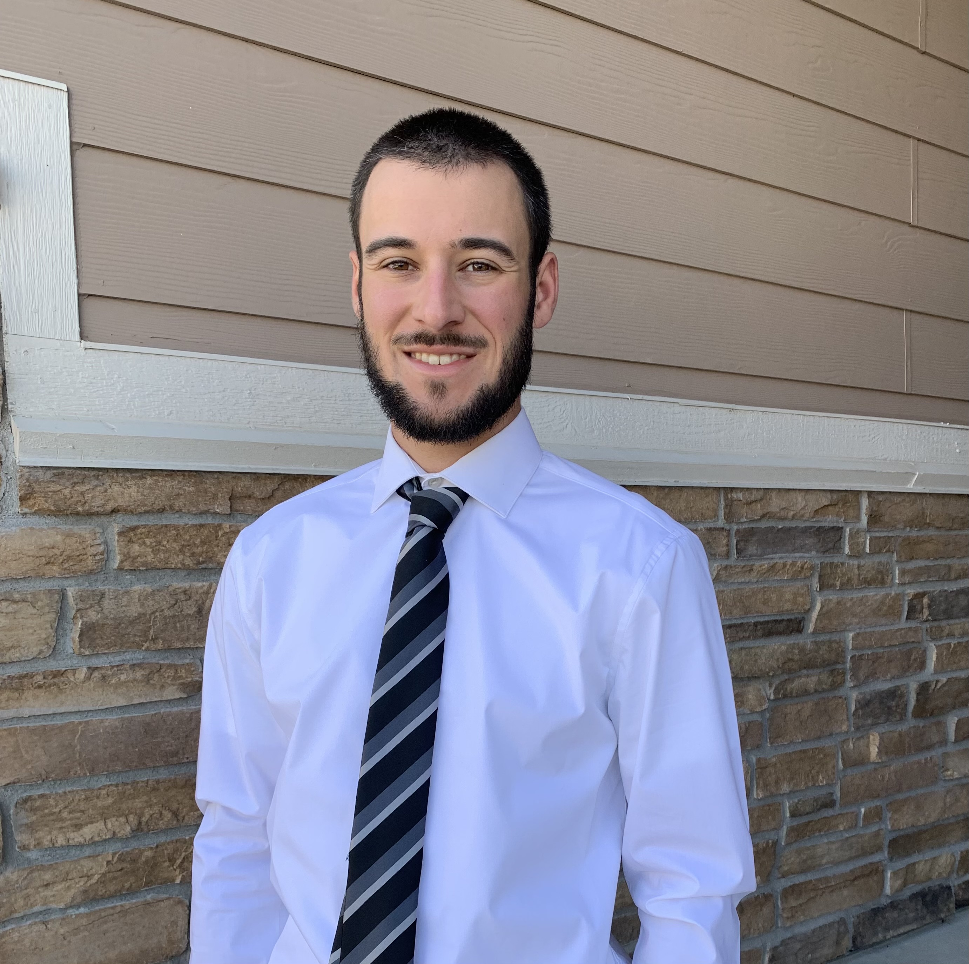


Meet the User Support Team
Layla Freeborn
Brandon Reyes
Andy Monaghan
Michael Schneider
John
Reiland
Dylan Gottlieb
Mohal Khandelwal
Ragan
Lee

Slide 4
Outline
What is the Cloud?
Services offered
Advantages of using the Cloud
Shared Responsibility Model
Example Use-Cases
Cost-Saving Considerations
Live Demo
Learning Materials
How to get started

Slide 5
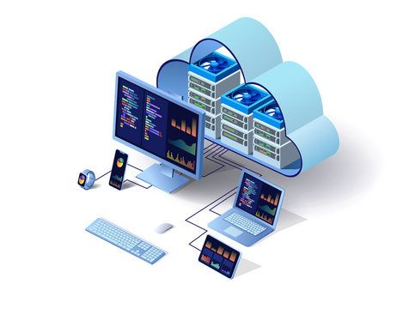
What is the Cloud?
"The cloud" refers to servers that are accessed via the Internet. This includes the Operating Systems, software, and databases that run on those servers.

Slide 6






Commercial Cloud Providers
Amazon AWS
Microsoft Azure
Google Cloud Provider
Many more

Slide 7
Cloud Service Models: IaaS, PaaS, and SaaS
Everything as a Service (XaaS) – a business model (generally subscription based) in which something is provided to the customer as a service
Infrastructure as a Service (IaaS) - Raw IT resources offered to the user by the cloud service provider
Most control, most advanced setup
Servers
Networking

Slide 8
Cloud Service Models: IaaS, PaaS, and SaaS
Platform as a Service (PaaS) – A platform that a provider offers to its customers via the internet
Some control, simplified setup
Windows Virtual Machine
Software as a Service (SaaS) - Software that runs on a provider’s infrastructure
Least control, most simple setup
Jupyterhub

Slide 9
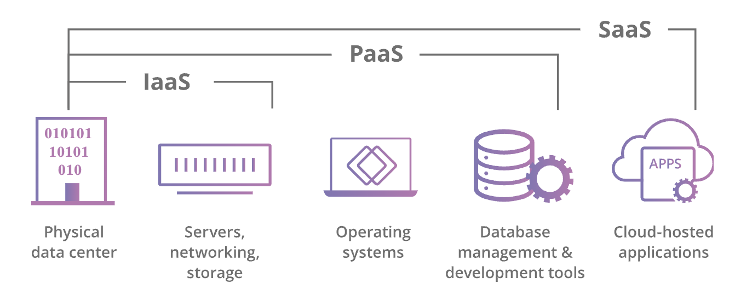
Cloud Service Models

Slide 10
Why use the cloud?
Availability
Data durability
99.999999999% (11 9's) of data durability
"If you store 10,000 objects with us, on average we may lose one of them every 10 million years or so.” – Jeff Barr (AWS)
Quick and easy Scalability
Get closer to the data
Wide array of Computing Power
Cost
Alleviate operational burden

Slide 11
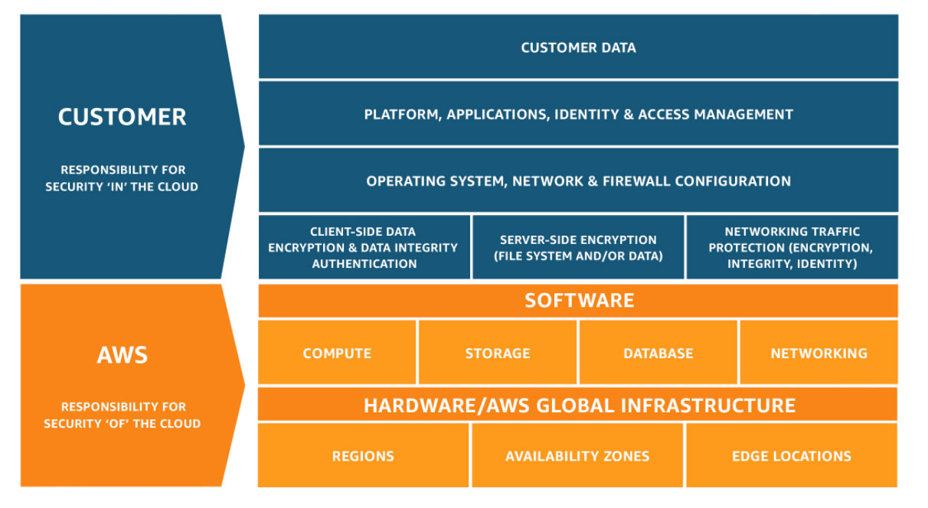
Shared Responsibility Model

Slide 12
Example use-cases
Netflix
Using cloud to meet needs for expensive or otherwise unavailable resources (e.g., specialized GPUs, huge amounts of RAM)
Using cloud computing to be "near" huge bioinformatics or geophysical datasets that are impractical to download (because these huge datasets are often stored in the public cloud)
Teaching "hubs" such as Rstudio and Jupyter, which provide a common software environment for all students

Slide 13

What scares you about working in the cloud?

Slide 14
Cost-Saving Considerations
Budget Alerts and Actions – Alert when budget is reached and shutdown resources
Analyze Cost Data – Understand cost on a resource level
Spot Instances – Utilize cloud provider's unused resources at discount
Reserved Instances – Commitment to use VM for extended period at a discount
Autoscaling – Scale resources as demand grows
Utilizing serverless functions – 1 million requests/month free
Microservices - Separate monolithic applications into smaller pieces
Appropriate Storage Options – Utilize cold storage when applicable

Slide 15

Cloud DEMO
Notes:
http://bit.ly/OIT-AWS

Slide 16
Learning Materials
AWS Educate
Azure Learn
Google Cloud Training
AWS Events on Campus
Build Chatbots with Amazon Bedrock Knowledge Bases and Agents – Nov 5
Building with Generative AI Apps on AWS – Nov 12

Slide 17
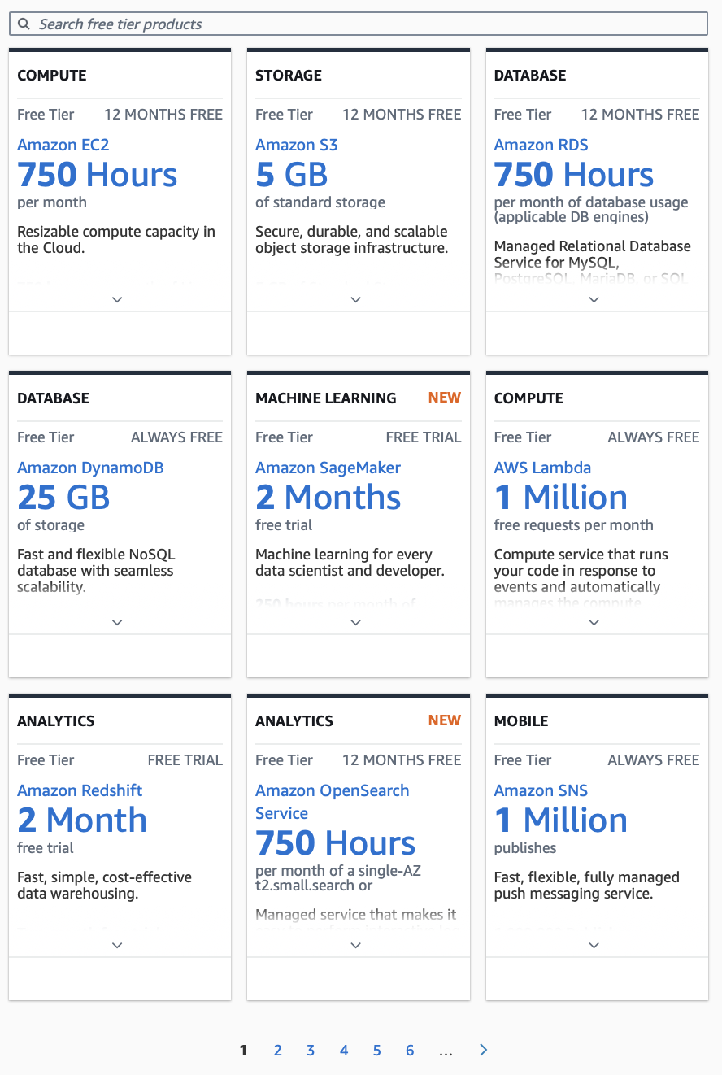
AWS Resources
Free Trials offered by AWS
AWS Free Tier

Slide 18
Azure Resources
Microsoft Student
Free $100 credit for students
Free trials of services

Slide 19
Google Cloud Resources
Google Free Tier
Free trials of services

Slide 20
How to get started
Reach out to the Cloud Foundations Service at CU
https://www.colorado.edu/rc/userservices/contact
Cloud Foundations Service
Amazon AWS, Microsoft Azure, & Google Cloud Platform
What we Offer
Basic Security Guardrails
Billing against CU funds (Purchase Order / Speedtype)
Connection to internal CU network
Federated Access
Support & Consulting
Notes:
We'll help to provision the resources you need, estimate costs for these resources.
We'll work with you on budgeting.

Slide 21

Survey and feedback
Survey: http://tinyurl.com/curc-survey18
Slides: https://github.com/ResearchComputing/cloud101_primer

